Slide 1
Extending InnoSwitch™3 IC Families With GaN Switches
July 25, 2019

Slide 2
InnoSwitch3 (CE/CP/Pro) ICs Achieve > 100 W
InnoSwitch3 silicon transistors are highly effective up to 65 W
Size 7 is the lowest R_{DS(ON)} silicon MOSFET that will fit in the InSOP-24 package
PI GaN switches provide more power
Lower R_{DS(ON)} per unit area
Lower switching losses
InnoSwitch3-CP – constant power
InnoSwitch3-EP – for open frame
InnoSwitch3-Pro – digital control
GaN switches

Slide 3
Applications with Size AND Efficiency Needs
Aftermarket USB PD adapters
High-end cellphone chargers and other mobile devices
Notebook adapters
Products with size OR efficiency needs
Appliances, TVs, server standby, AIO PCs, video games
Applications requiring feature benefits of InnoSwitch, but need more power

Slide 4
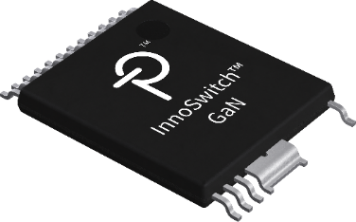
Making GaN Easy to Use
GaN transistors are better than silicon
More efficient, cooler, smaller power supplies
Leading the way to “no-heatsink” designs at high power levels
GaN transistor technology is the future for power conversion
Our strategy is to enclose and protect the GaN device within our ICs
Engineers see significant performance benefits
But won’t otherwise notice a change

Slide 5
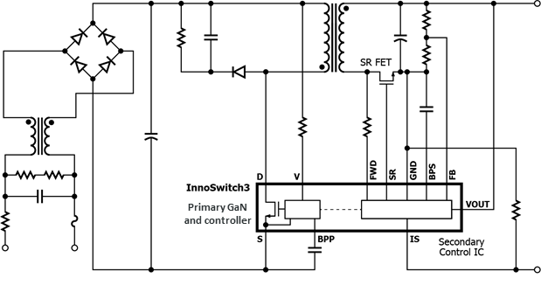
Consistent, Familiar and Easy to Implement
Simple flyback circuit topology
Use identical SMPS design flows for silicon and GaN InnoSwitch3 ICs
Identical switching frequency
External components scale for power
Switching waveforms are very similar
No unusual behaviors or concerns
EMI Standard techniques
ESD No different from silicon

Slide 6
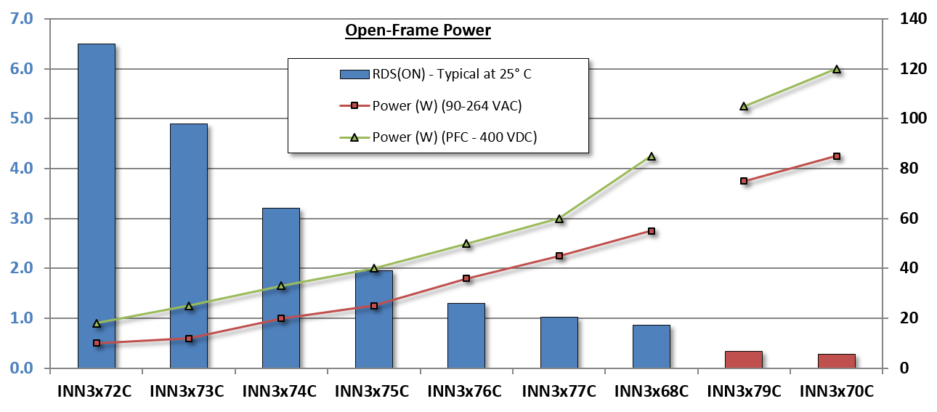
GaN Increases InnoSwitch3 Efficiency and Power
R_{DS(ON)} (Ω) – Typical (25 °C)
Output Power (W)

Slide 7
Wide Power Range and High V_{DS(MAX)}
Product | Adapter Rating (W) | InnoSwitch3 |  |  |  | InnoSwitch3-Pro
 | 85-265 VAC | 650 V | 725 V | 750 V | 900 V | 650 V | 725 V | 750 V
INN36y2C | 10 |  |  |  | 
INN36y3C | 12 |  | 
INN36y4C | 15 |  |  |  |  |  | 
INN3xy5C | 22 |  |  |  |  |  | 
INN3xy6C | 27 |  |  |  |  |  | 
INN3xy7C | 40 |  |  |  |  |  | 
INN3xy8C | 50 |  |  |  |  | 
INN3xy9C | 65 |  |  |  |  |  |  | 
INN3xy0C | 75 |  |  |  |  |  |  | 
X = InnoSwitch3 Product family
2 = CP
3 = Pro
6 = EP
Y = Primary Switch Voltage Rating
6 = 650 V
7 = 725 V / 750 V
9 = 900 V

Slide 8
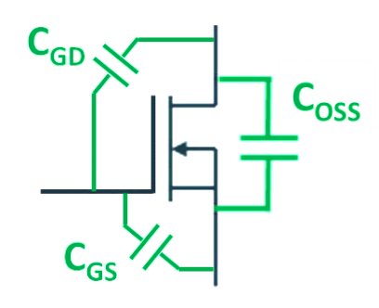
GaN Switches Significantly Reduce Losses
MOSFET output capacitance is discharged through itself at turn-on
Parasitic capacitances are proportional to the size of the MOSFET
Bigger MOSFET = more switching loss
Also lower R_{DS(ON)} means less conduction loss
Drain
C_{DS}
f . C_{OSS} .V²
f = Switching frequency
V = Peak of VAC ~ 400 V
C_{OSS} = C_{DS} + C_{GD}
P_{(Loss)} =
Gate
2
Source

Slide 9
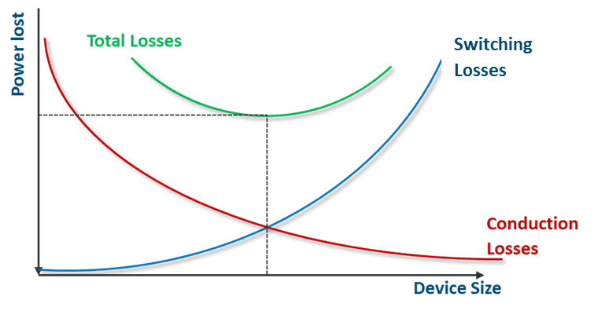
Switching Losses Increase with FET Size Conduction Losses Decrease with FET Size
Switching Loss
(MOSFET)
(CV²)
Total Power Loss (MOSFET)
Power lost with conventional MOSFET
(I²R)
Conduction losses and switching losses work in opposite directions

Slide 10
GaN Switches Change the Curve
Total Power Loss (MOSFET)
Power lost with conventional MOSFET
Total Power Loss GaN
Switching Loss
GaN
Power lost with GaN Technology
Conduction losses and switching losses work in opposite directions

Slide 11
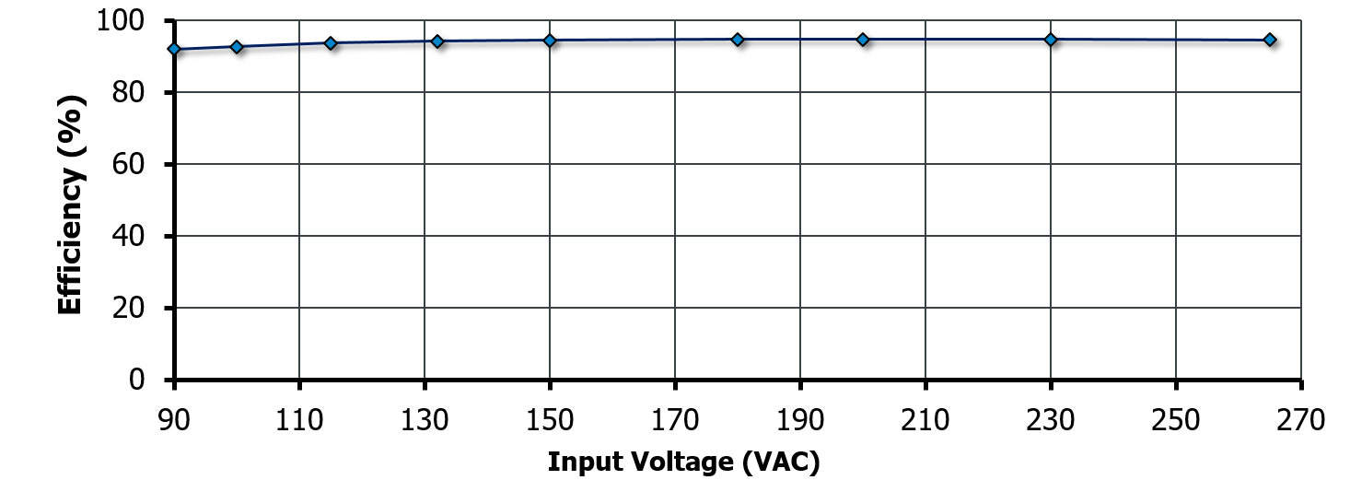
GaN-Based Design Achieves 95% Full-Load Efficiency -Allows Elimination of Heatsinks from Adapter Designs
DER-747 (65 W, 20 V Adapter): Full-load efficiency is 95% at 230 VAC and 94% at 115 VAC

Slide 12
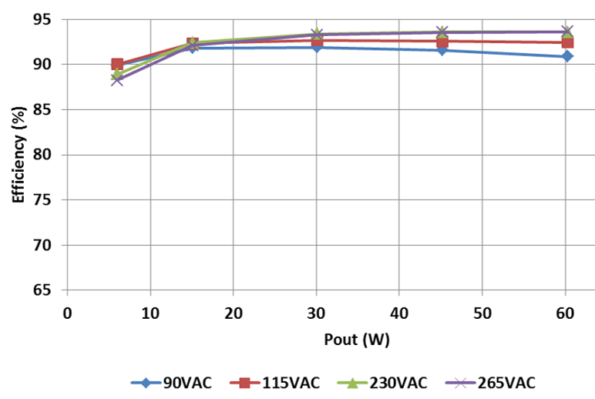
GaN High Efficiency Also Improves Performance Across Load for 60 W USB PD
Same high-efficiency-across-load as standard InnoSwitch3
Ideal for high-power USB PD applications
Average efficiency is 92.49% at 115 VAC and 93.24% at 230 VAC

Slide 13
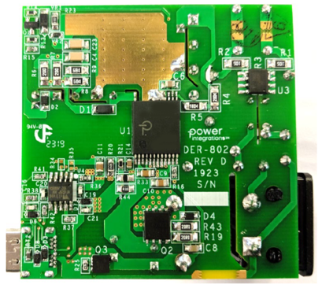
Available GaN Reference Designs
InnoSwitch3 for USB PD baseline design
DER-601 60 W USB PD (WT6635P)
DER-602 100 W USB PD (WT6635P)
DER-747 65 W Non-USB PD adapter
InnoSwitch3-Pro for USB PD + PPS design
DER-802 60 W USB PD (WT6635P)
DER-803 60 W USB PD (VP302)
DER-805 100 W USB PD (VP302)

Slide 14
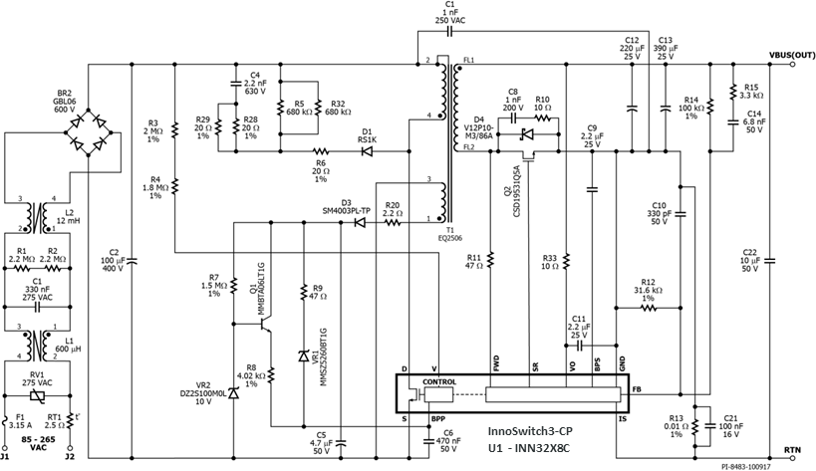
Summary: GaN – Powerful, Efficient, Reliable
PI GaN devices deliver more power
Reduced on-resistance
Lower switching loss
Circuit operation indistinguishable from one using silicon devices
Manufacturing processes developed and maintained by PI
Working with established partners
Industry-leading GaN qualification process
65 W Reference Design Using INN32X9C

Slide 16
Q&A Slides

Slide 17
Supply Chain Questions
The technology we are using is proprietary to Power Integrations
PI GaN transistor fabrication done at existing silicon fab partners
InnoSwitch3 Size 9 and 10 devices use the same assembly and test facilities as silicon InnoSwitch3 parts
Comprehensive technology qualification meets exacting PI standards

Slide 18
GaN Qualification Mirrors Silicon Product Qual. Protocol
 | Test Description | Symbol | Test Method | InnoSwitch3 | InnoSwitch3 (GaN)
Fab Process | Preconditioning & Moisture Sensitivity Level | PC | JESD22-A113 | MSL3 | MSL3
 |  |  | JEDEC J-STD-020 | MSL3 | MSL3
 | Temperature Humidity Bias | THB | JESD22-A101 | Multiple units, multiple lots | Multiple units, multiple lots
 | Temperature Cycling | TC | JESD22-A104 | Multiple units, multiple lots | Multiple units, multiple lots
 | High Temp. Storage Life | HTSL | JESD22-A103 | Multiple units, multiple lots | Multiple units, multiple lots
 | Dynamic Operating Life | DOPL | JESD22-A108 | Multiple units, multiple lots | Multiple units, multiple lots
Fab and Package | Highly Accelerated Life Test | HALT | JESD22-A104 | Multiple units, multiple lots | Multiple units, multiple lots
 | High Temp. Reverse Bias | HTRB | JESD22-A108 | Multiple units, multiple lots | Multiple units, multiple lots
Packaging Process | Preconditioning | PC | JESD22-A113 | Multiple units, multiple lots | Multiple units, multiple lots
 | Moisture Sensitivity Level | PC | JEDEC J-STD-020 | Multiple units, multiple lots | Multiple units, multiple lots
 | Temperature Humidity Bias | THB | JESD22-A101 | Multiple units, multiple lots | Multiple units, multiple lots
 | Temperature Cycling | TC | JESD22-A104 | Multiple units, multiple lots | Multiple units, multiple lots
 | High Temp. Storage Life | HTSL | JESD22-A103 | Multiple units, multiple lots | Multiple units, multiple lots

Slide 19
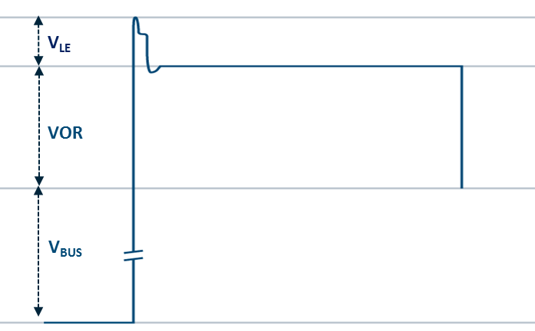
PI’s GaN is Extremely Robust
750 V = V_{MAX(non-repetitive)}
Safe Surge Voltage Region (SSVR)
Typical margin (150 V)
Gives de-rating of > 80%
650 V = V_{MAX(continuous)}
~530 VDC
380 VDC
Primary Switch Voltage Stress (264 VAC)

Slide 20
Customers
We do not release the names of our customers
The following customers have been identified by Yole in their report
Anker, Aukey, Ravpower
We are not releasing shipping volumes, backlog or GaN-based revenue information at this time

