Slide 1
Cloud HPC for PathWave ADS 2021 is Here!
Stephen Slater, Dan Schwarz
Keysight Technologies

Slide 2
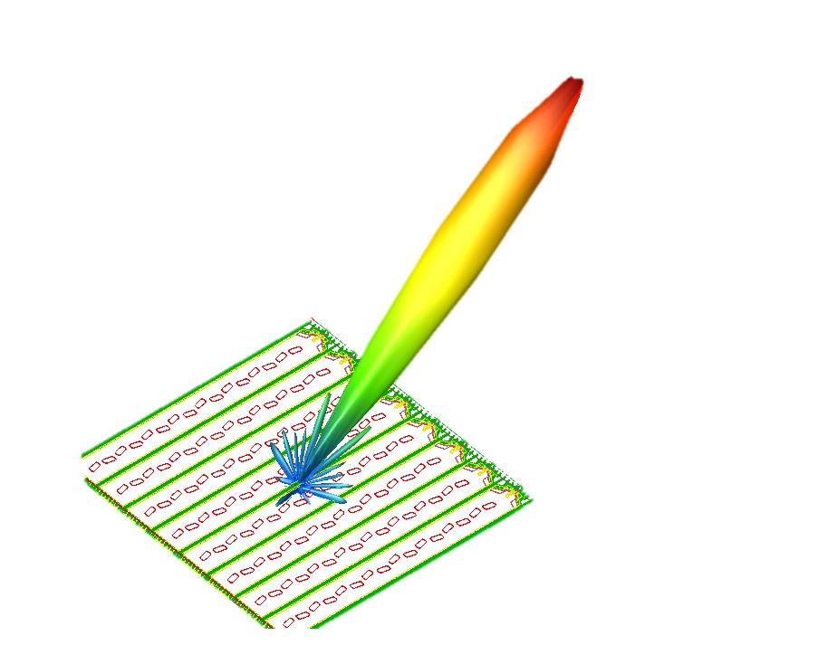
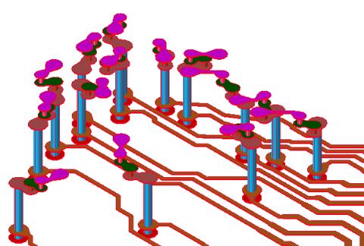
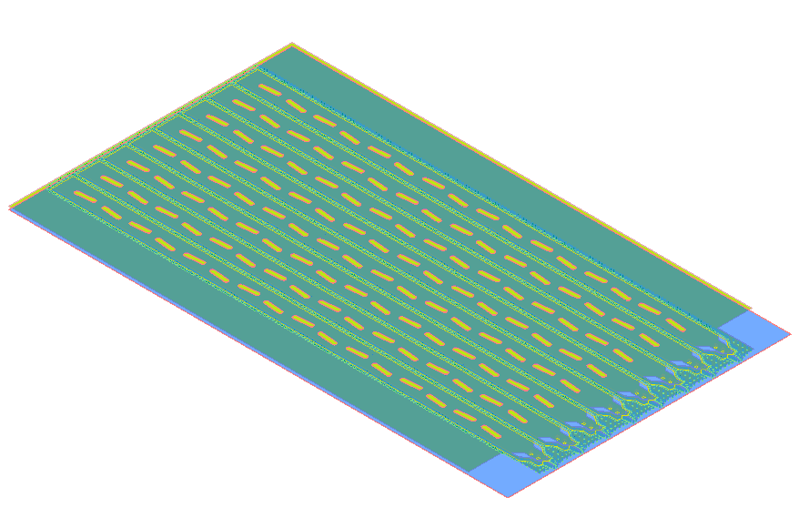
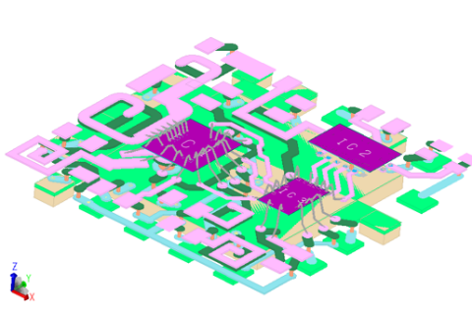
Designs are Becoming More Complex
Antenna Designer
MMIC Module Designer
Signal Integrity Engineer
I need to design an array and simulate for multiple frequency bands.
I need to calculate the antenna pattern with a high degree of accuracy.
I need to simulate for more modes of operation than ever, across multiple frequency bands.
I care about the interplay of the package, the interconnects and the IC layout.
I want to verify every high-speed digital signal net on my PCB.
I need to capture crosstalk between these signals accurately.
100s of Array Elements + High Frequency
Electrically Large features + Electrically small Features
Many signal nets + high frequency

Slide 3
3 Designers – 1 Problem
“There’s not enough time to simulate everything I want!”
Specs
Prior Art
Investigation/Reuse
Func
Reqs
Schematic
Circuit Simulations
EM Sim
Design Iteration
#1
EM Sim
Design Iteration
#2
. . . . . .
EM Sim
Design Iteration
#YY
Expected Design Sign-Off
Fixed Target Date

Slide 4
3 Designers – 1 Solution
Simulate More. Wait Less. Reduce Risk.
Enjoy Higher Confidence at Design Sign-Off
Specs
Prior Art
Investigation/Reuse
Func
Reqs
Schematic
Circuit Simulations
EM Sim Coverage
More Test Coverage
Expected Design Sign-Off
Fixed Target Date

Slide 5
Keysight Design Cloud
Higher HPC Asset Utilization
Dynamic Enterprise Agreements
Simple HPC Licensing
Cloud scaling for peak demand
Enabling Predictive, Productive Design Cycles

Slide 6
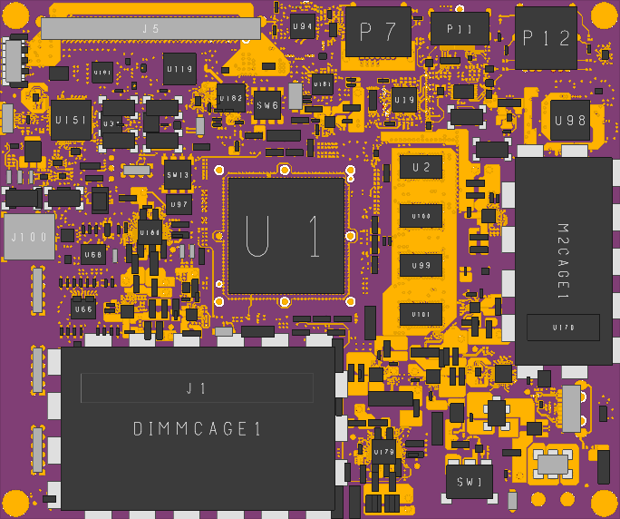
Xilinx Zynq ZCU Evaluation Board
Signal integrity EM CASE STUDY
CHALLENGE
Capture all DDR4 Data Lines, Data Strobes and Data Masks
88 Signal Nets – 16 Layer PCB
Simulation Freq range of DC-10GHz
44 Freq Points & 176 Ports
SOLUTION
SIPro within PathWave ADS
7x HPC EM Droplet Licenses
8x 16 core 128GB RAM nodes on Nimbix Cloud HPC Platform

Slide 7
Xilinx Zynq ZCU Evaluation Board
Signal integrity EM CASE STUDY
RESULTS
Single Sim Time
14 Hours 50 mins
Nimbix HPC Sim Time
2 Hours 27 mins
CHALLENGE
Capture all DDR4 Data Lines, Data Strobes and Data Masks
88 Signal Nets – 16 Layer PCB
Simulation Freq range of DC-10GHz
44 Freq Points & 176 Ports
SOLUTION
SIPro within PathWave ADS
7x HPC EM Droplet Licenses
8x 16 core 128GB RAM nodes on Nimbix Cloud HPC Platform
EM extraction time reduced by 83%

Slide 8
Ok… But What is HPC?

Slide 9
Define: HPC
High Performance Computing (HPC) is the use of parallel processing algorithms and systems to Solve Complex Computational Problems.
It incorporates both administration and parallel computational techniques, to aggregate computing power and deliver much higher performance; to solve large problems in science, engineering, or business.
Source: Techopedia.com

Slide 10
HPC Deployments
System Implementation Complexity
On-Premise Server
Typical Challenges:
User Authentication (SSO)
Shared File System
Application Plumbing
License Server visibility
Job Schedulers –
LSF
PBS
GridEngine
Slurm
HTCondor
On-Premise Cluster
Private Cloud
Hybrid Cloud

Slide 11
HPC Deployments
Turn-Key Cloud HPC Provider
Keysight Products Published to Nimbix Platform
All supplemental software already configured
QA Tested
Scalable HW resources
Pay-per-use HW resources

Slide 12
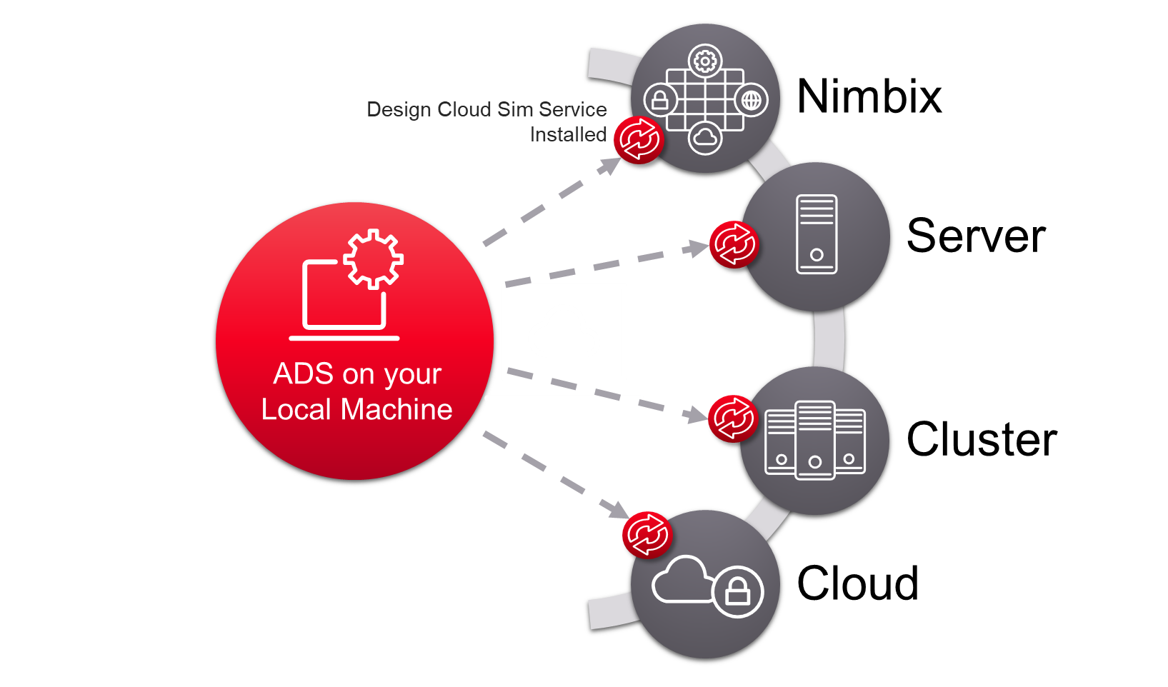
Introducing Keysight Design Cloud User-Experience
Setup your simulation on your local machine
Set number of parallel jobs
Design Cloud Sim Service interacts with Job Schedulers
Only the files that are needed are sent to Design Cloud Sim Service
Shut down your local machine – jobs are still running
Reconnect and if simulations are finished, results are automatically downloaded

Slide 13
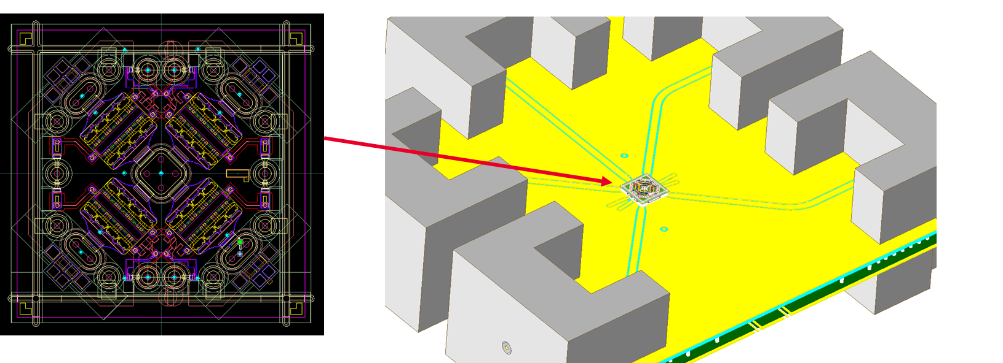
Momentum vs FEM: What’s the difference?
Momentum (Method of Moments) – Planar 3D EM simulator
IC’s, PCB’s, Antennas, any planar circuit.
FEM – (Finite Element Method) – Arbitrary-geometry 3D EM simulator
Module, Antennas, arbitrary structures
Single Sim Time
1 Hours 13 mins
Menlo Microwave MEMS switch on a Test Fixture.

Slide 14
EM Simulation Technology
Momentum vs fem, multi-threading and parallel compute
* Different steps within MoM or FEM utilize either multi-threading or parallelization over a cluster *
Sim Setup
Momentum
Multi-threaded
Substrate Calc
Momentum uW mode
Multi-threaded
Initial Mesh
Multi-threaded
Mesh Refinement
FEM
Multi-threaded
Multi-threaded & Parallel Simulation
Solve
No additional licenses required for multi-threading!

Slide 15
How is Parallel Simulation Applied by EM Solvers?
Distributed Frequency POINTs
RFPro FEM Sim
Freq Pts = 41
Set Number of Max Parallel Jobs = 4
Job on Node 1
Job on Node 2
Job on Node 3
Job on Node 4
Freq Pts = 11
Freq Pts = 10
Freq Pts = 10
Freq Pts = 10
An RFPro Simulation License + 3x HPC EM Droplet Licenses = 4 Parallel Jobs

Slide 16
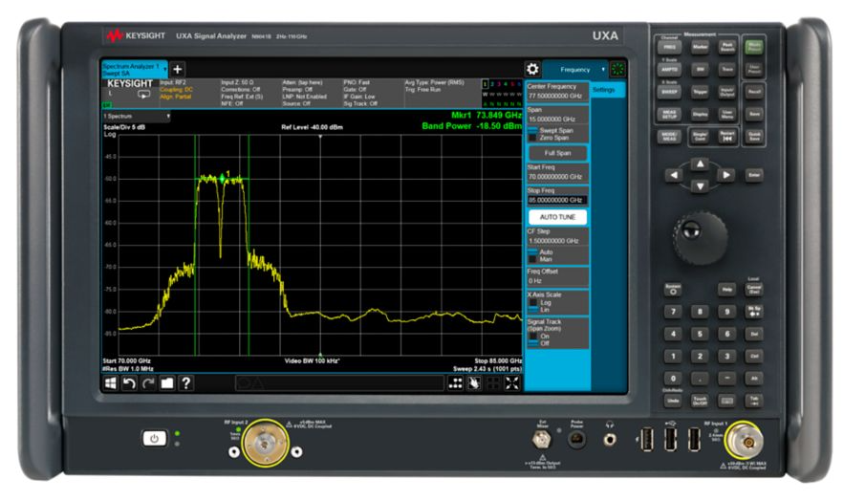
Keysight Labs – N9041 LO Converter
CASE STUDY #1
CHALLENGE
Integrate mixed-signal PCB with connectors and housing
Simulate ‘classic’ microwave signal path to capture circuit/cavity response
Simulation frequency range of DC-55 GHz
56 frequency points & 8 ports
SOLUTION
PathWave ADS integrated with EMPro
3x HPC EM Droplets Licenses
4x 16 core machines on Keysight Internal HPC Cluster

Slide 17
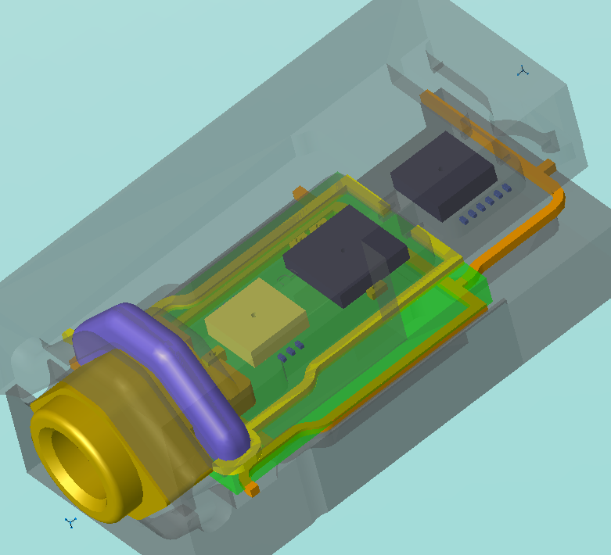
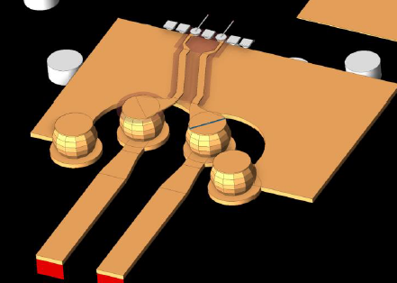
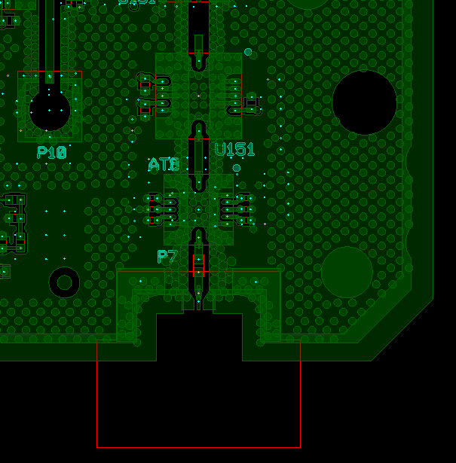
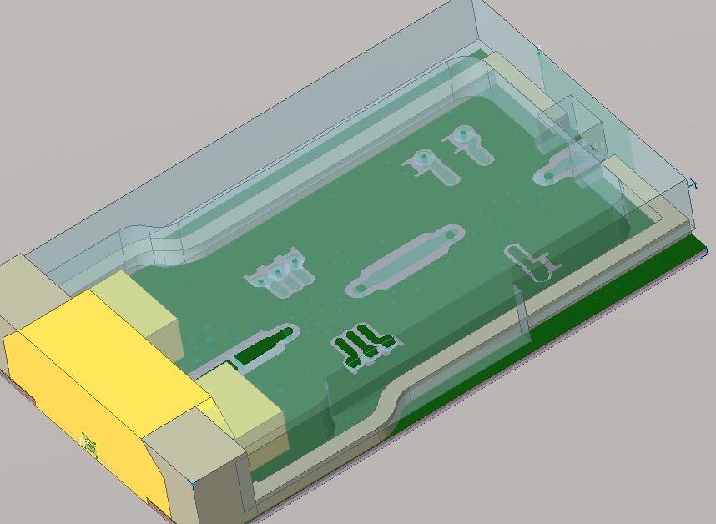
Keysight Labs – Constructing the Module
CASE STUDY #1

Slide 18
Keysight Labs Reduced EM Extraction Time by 79%
CASE STUDY #1 – Results
RESULTS
Local 6 Core (i9) Machine
3 Hours 21 mins
Keysight HPC Single Node
1 Hours 30 mins
CHALLENGE
Integrate mixed-signal PCB with connectors and housing
Simulate ‘classic’ microwave signal path to capture circuit/cavity response
Simulation frequency range of DC-55 GHz
56 frequency points & 8 ports
SOLUTION
PathWave ADS integrated with EMPro
3x HPC EM Droplets Licenses
4x 16 core machines on Keysight Internal HPC Cluster
Keysight HPC x4 Node
42 mins
EM extraction time reduced by 79%

Slide 19
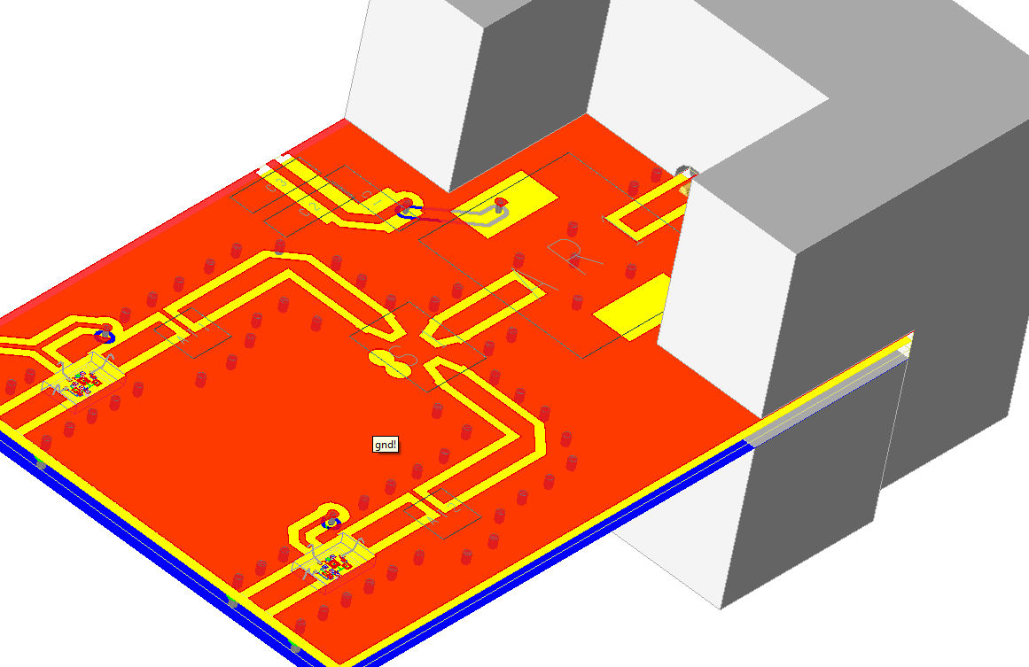
Multi-technology Module Design
CASE STUDY #2
CHALLENGE
Integrate MMIC LNA with bondwires on parent assembly with 3D connector
Simulate module performance from connector to internal MMIC geometry
Simulation frequency range of DC-26.5 GHz
53 frequency points & 5 ports
SOLUTION
PathWave ADS RFPro
7x HPC EM Droplets License
8x 16 core 128GB RAM nodes on Nimbix HPC Platform

Slide 20
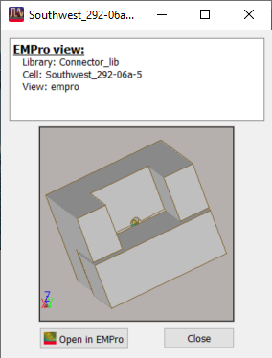
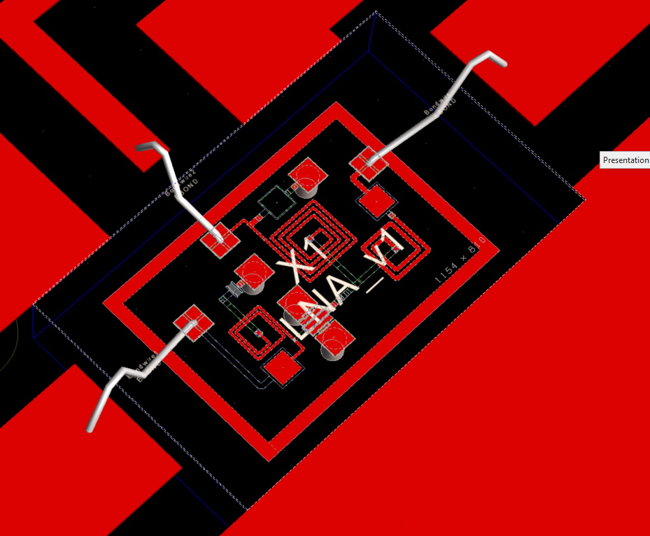
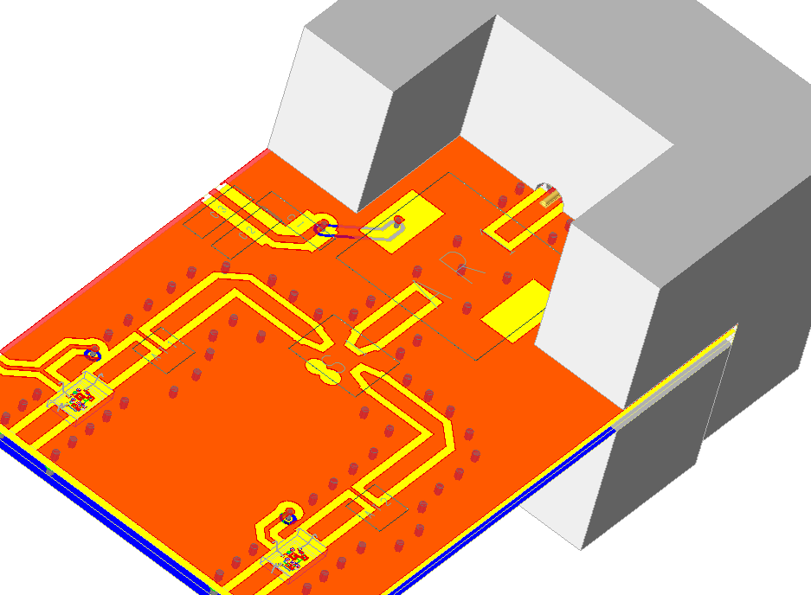
Multi-technology Module Design
CASE STUDY #2 – constructing the module

Slide 21
Multi-technology Module Design
CASE STUDY #2 – Results
RESULTS
Local 6 Core (i9) Machine
2 Hours 56 mins
Nimbix HPC Single Node
1 Hours 13 mins
CHALLENGE
Integrate MMIC LNA with bondwires on parent assembly with 3D connector
Simulate module performance from connector to internal MMIC geometry
Simulation frequency range of DC-26.5 GHz
53 frequency points & 5 ports
SOLUTION
PathWave ADS RFPro
7x HPC EM Droplets License
8x 16 core 128GB RAM nodes on Nimbix HPC Platform
Nimbix HPC x8 Node
30 mins
EM extraction time reduced by 83%

Slide 22
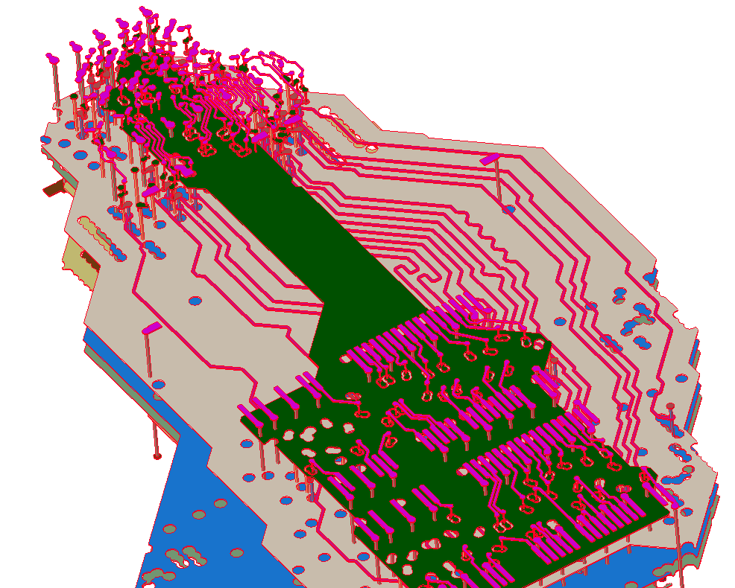
SECO Embedded System Board with DDR4
CASE STUDY #3
CHALLENGE
DIMM based system
Capture all DDR4 command address buses, clocks and control lines
48 signal nets; 12-layer PCB
Simulation frequency range of DC-10 GHz
37 frequency points & 100 ports
SOLUTION
SIPro within PathWave ADS
11x HPC EM droplet licenses
12x 16 core 128GB RAM nodes on Nimbix Cloud HPC platform
Design Cloud sim service starts machines on Nimbix (on-demand)

Slide 23
SECO Embedded System Board with DDR4
CASE STUDY #3
RESULTS
Hours
CHALLENGE
DIMM based system
Capture all DDR4 command address buses, clocks and control lines
48 signal nets; 12-layer PCB
Simulation frequency range of DC-10 GHz
37 frequency points & 100 ports
SOLUTION
SIPro within PathWave ADS
11x HPC EM droplet licenses
12x 16 core 128GB RAM nodes on Nimbix Cloud HPC platform
Design Cloud sim service starts machines on Nimbix (on-demand)
Parallel Jobs
On-demand HW scaling reduced sim time by 84%

Slide 24
Simulate More. Wait Less.
Cloud HPC with PATHWAVE ADS 2021
Higher HPC Asset Utilization
Dynamic Enterprise Agreements
Simple HPC Licensing
Cloud scaling for peak demand
Enabling Predictive, Productive Design Cycles

Slide 25
Key Points
With the new Design Cloud sim service, we can now easily parallelize multiple frequency points directly from SIPro, PIPro, RFPro, and PEPro with significant speed advantage – n parallel jobs results in a duration of the simulation >1/n, for linear frequency sweeps
We used to sell only 8-pack licenses, now we have HPC 1-packs which can be bought in the desired quantity and allow a corresponding number of parallel simulations (i.e., Simulator license + 3x 1-pack licenses available = 4 parallel jobs)
These 1-packs can be used with clusters directly owned by the customer (probably the most likely case for large accounts) or on web services i.e., Nimbix (should be more attractive for small enterprises) to add extra simulation capacity without capital investment
We sell W3039E Pathwave EM HPC 1-pack for parallel EM simulations, demonstrated with Design Cloud use model.
We sell W3029E Pathwave circuit simulation HPC 1-pack (still using the old Simulation Manager which does not support Design Cloud use-model) to parallelize circuit simulation batch/sweeps. Except for Ptolemy-co-sim, EM-co-sim, VTB(SystemVue)-co-sim, and Thermal

